Slide 1
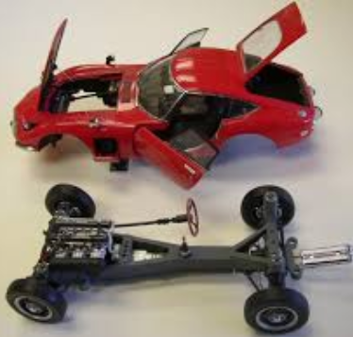
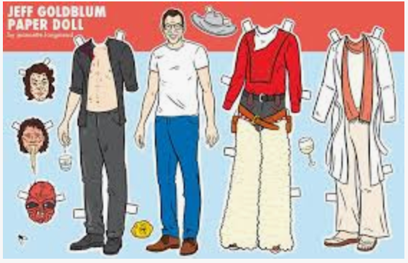
Model of Whiteville-

Slide 3
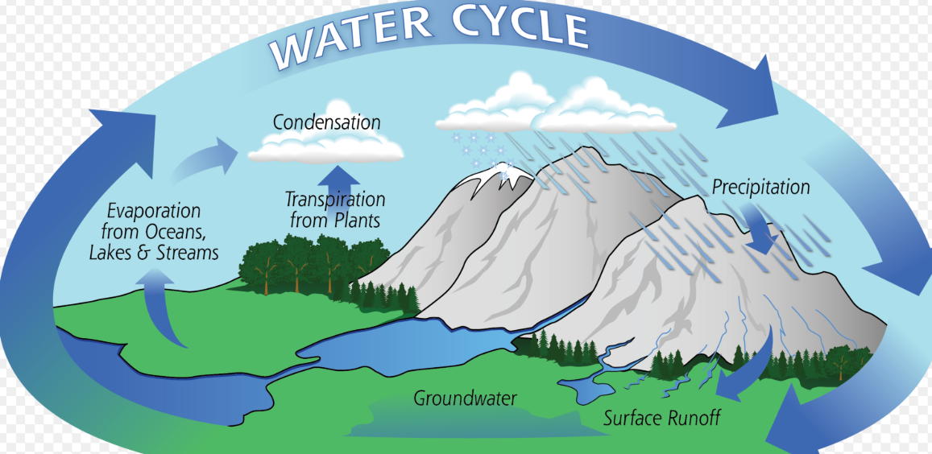
EXAMPLES of Scientific Models

Slide 4
SocrAEvic Questioning of scientific models
Saving the world……by overturning one misconception at a time!

Slide 6
Presenter Name: Ms. Evans Topic: My Dog! Poster:
How can you help me with my misconception while following the Socraevic Method?

Slide 7
Presentation #1

Slide 8
Presentation #1 :Clarification
List 4 questions you could ask for further understanding: (Just jot them down and we can share)
What does it say next to object 2 and why was it
Important for you to put it there?
2) Are the objects made of the same stuff?
3) What is moving in your diagram? The objects? The particles?
4) Where would y=mx+b apply to your presentation? What is happening at “b”?

Slide 9
Presentation #1 :Deeper understanding
List some questions you could ask for further understanding:
(just jot them down and we will share)
What is Kinetic Energy?
-Can you give a sentence to explain the kinetic energy of object 1 to object 2?
2) What word could you use instead of
motion on your graph?
3) What happens when Thermal Energy is zero?
-Can you describe in a sentence what zero thermal energy means?
How could you show motion for object 2?
-Can you show relative motion in object 2?

Slide 10
Presentation #2 :Revealing misconceptions/”wrong turns”
Which of the following is the BEST Socraevic question to ask?
Can you explain why this is balanced?
Isn’t oxygen diatomic?
What are the diatomic elements?
Why does the product only have one oxygen atom?

Slide 11
Presentation #3 :Guiding the presenter
Which of the following is the BEST Socraevic question to ask?
Isn’t Chromium +3?
Why did you put a II in the name?
Why do you have 3 carbonate ions?
Could you please flip the board over and
show just a carbonate ion on the right?

Slide 12
Now what???

