Slide 1
MEasurements

Slide 2
Measurements
-Quantities that have both a number and a unit
-Fundamental to accuracy so it is important to make careful measurements and determine if a measurement is valid.
WITHOUT accurate MEASUREMENTS, THE data OBTAINED IN THE LAB WILL BE useless!!

Slide 3
• Making Measurements
-In making a measurement, write down all of the measured (exact) digits that the device gives and also one last digit that you estimate
-Why would any digits be uncertain?
1) Instruments are not free of error
2) Measuring properly involves some technique

Slide 4
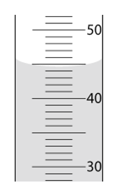
• Estimating Digits
-Digital Displays: the final digit on the display is the estimated digit
-Scales: With volume the bottom of the liquid surface (meniscus) is where the reading is taken… estimate the last digit
*MUST READ THE liquid AT _the bottom FOR AN accurate_ READING IN LAB!!
**exception=

Slide 6
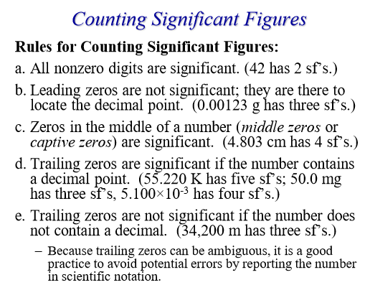

Slide 7
Rounding sig figs
5 or greater = round up

Slide 9
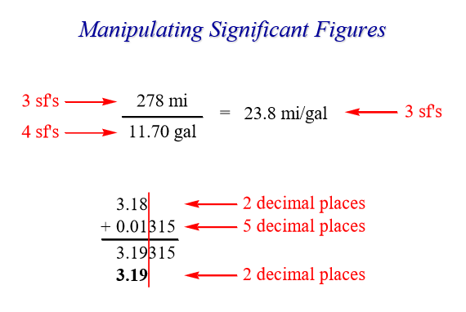

Slide 12
