Slide 1
1.2 and 1.3- Classification and Properties of Matter
EVANS
CCCA

Slide 2
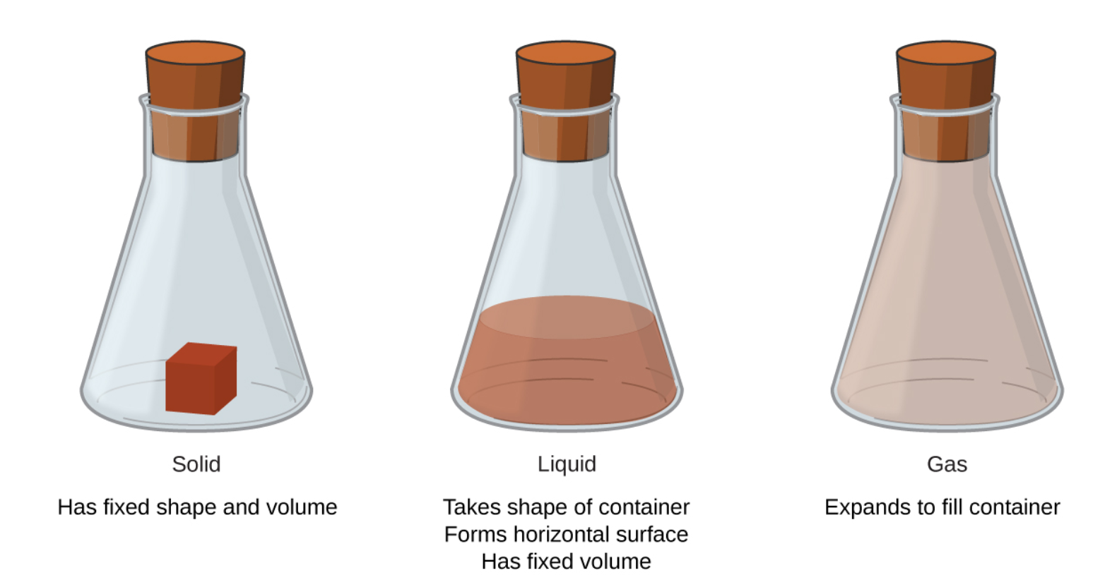
Matter is defined as anything that occupies space and has mass, and it is all around us.
. -also exhibits inertia…
STATES OF MATTER →

Slide 3
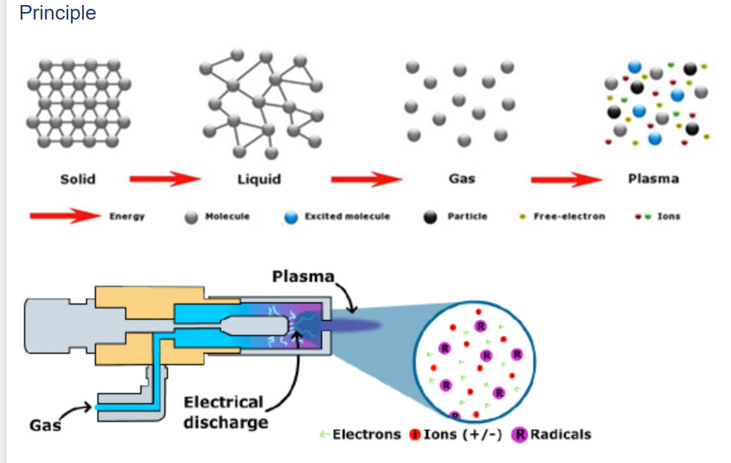
4th State of Matter
A fourth state of matter, plasma, occurs naturally in the interiors of stars. A plasma is a gaseous state of matter that contains appreciable numbers of electrically charged particles.

Slide 5
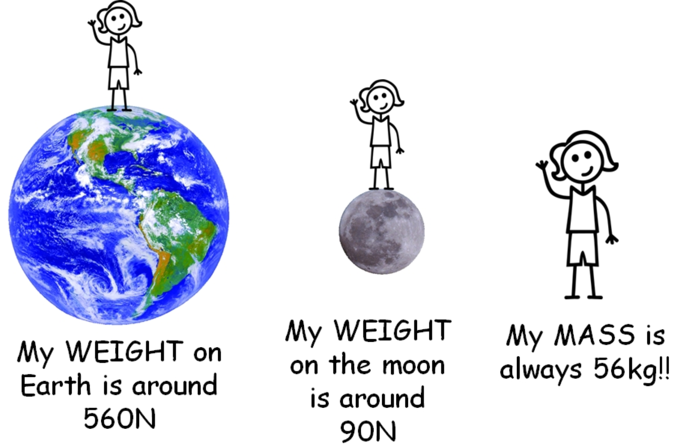
Mass vs. Weight

Slide 6
Law of Conservation of Mass
It states that there is no detectable change in the total quantity of matter present when matter converts from one type to another (a chemical change) or changes among solid, liquid, or gaseous states (a physical change).
Mass = Mass
Matter cannot be created or destroyed, only changed in form.

Slide 8
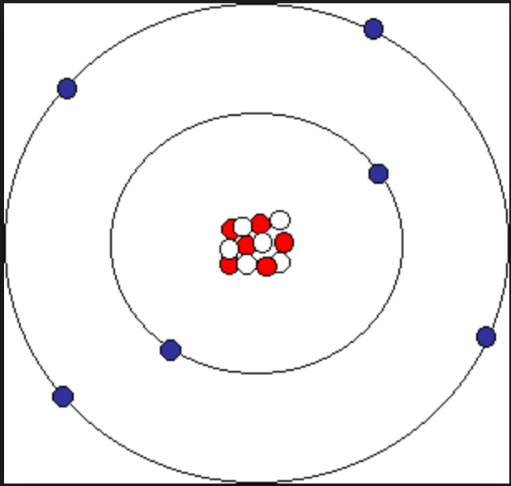
The Atom
An atom is the smallest particle of an element that has the properties of that element and can enter into a chemical combination.

Slide 9
The Molecule
A molecule consists of two or more atoms joined by strong forces called chemical bonds.
The atoms in a molecule move around as a unit, much like the cans of soda in a six-pack or a bunch of keys joined together on a single key ring. A molecule may consist of two or more identical atoms, as in the molecules found in the elements hydrogen, oxygen, and sulfur, or it may consist of two or more different atoms, as in the molecules found in water.

Slide 10
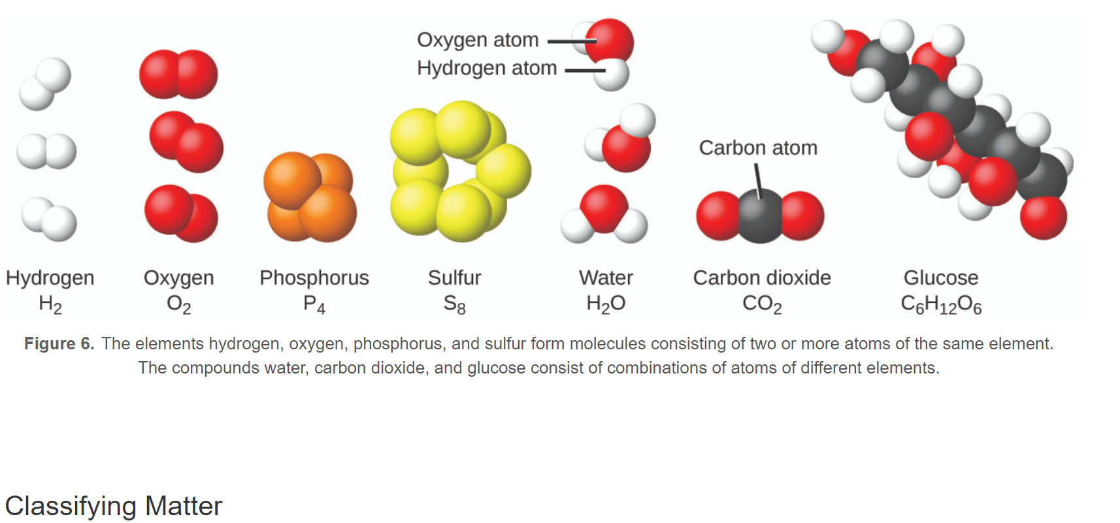

Slide 11
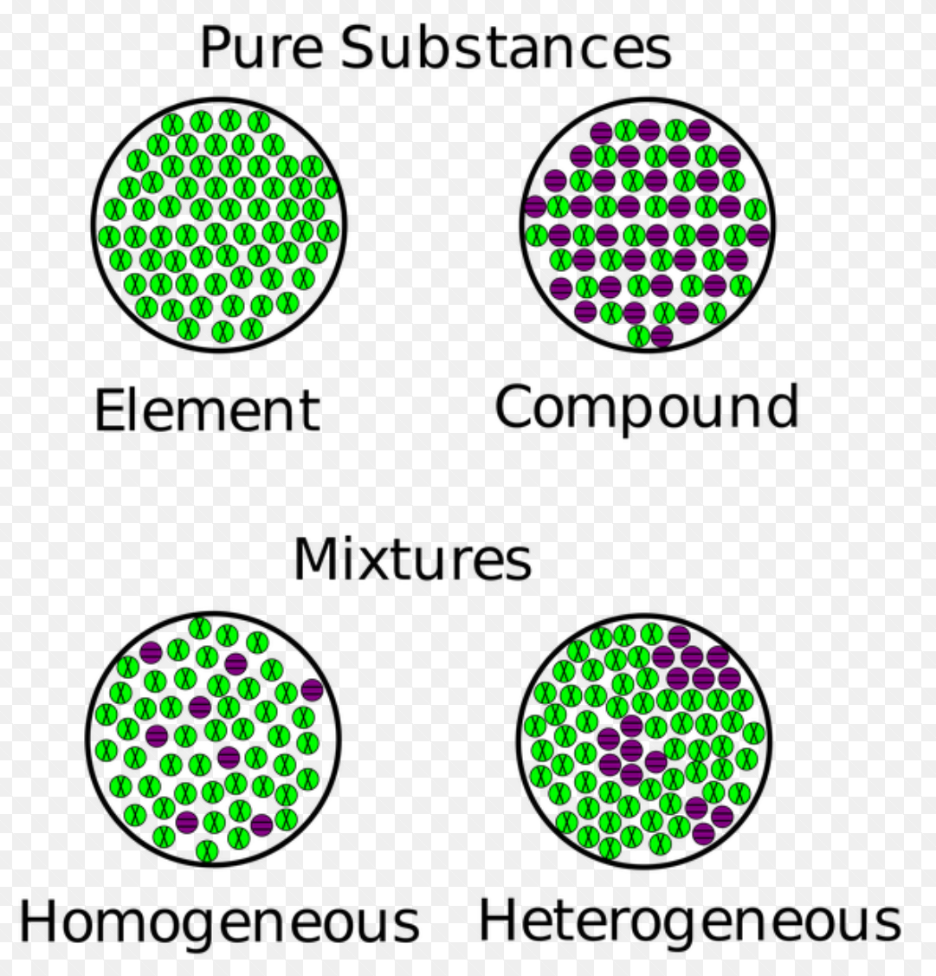
Classifying Matter
Pure substances- consist of only one type of atom (may be elements or compounds)
Mixtures- contain 2 or more pure substances (may be homogeneous or heterogeneous)

Slide 12
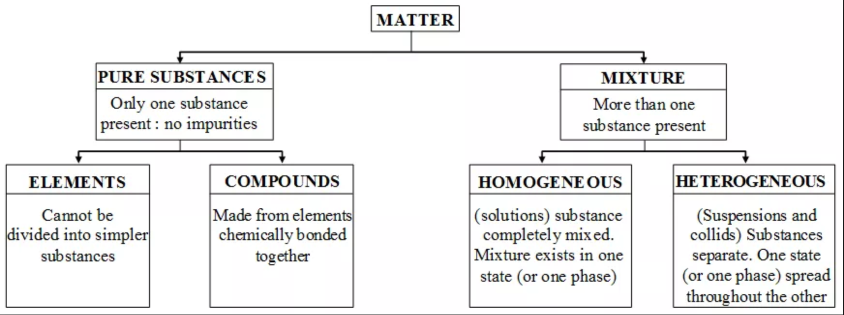
Classifying Matter

Slide 13
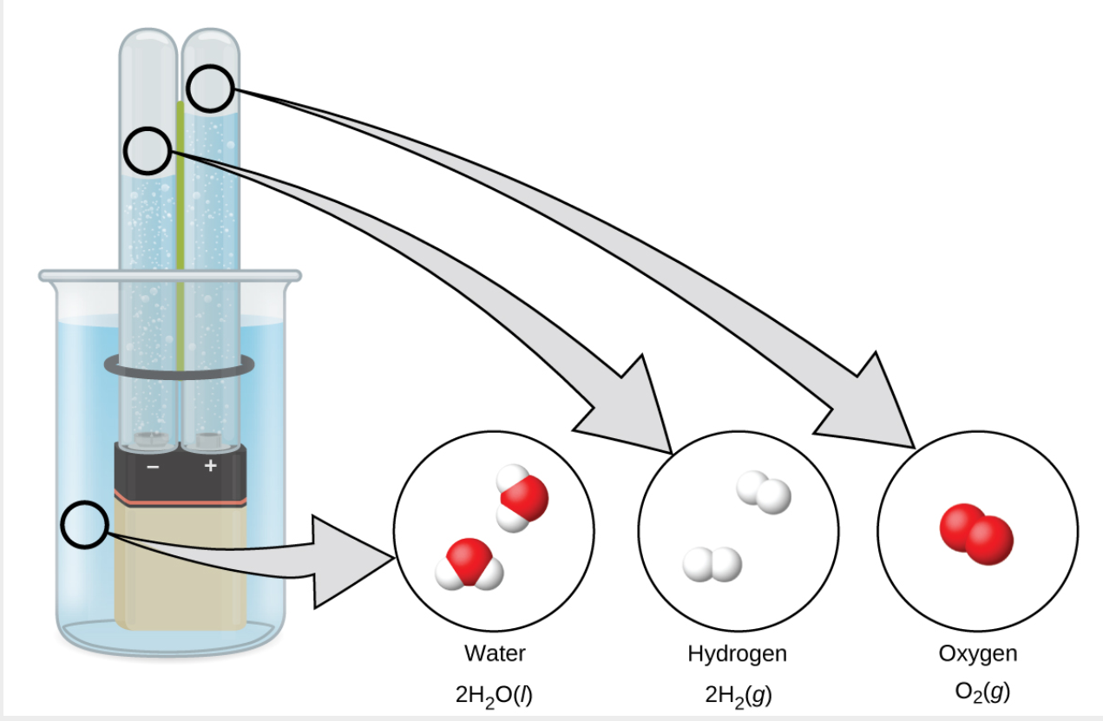
Electrolysis of Water

Slide 14
1.2 Vocabulary
atom
smallest particle of an element that can enter into a chemical combination
compound
pure substance that can be decomposed into two or more elements
element
substance that is composed of a single type of atom; a substance that
cannot be decomposed by a chemical change
gas
state in which matter has neither definite volume nor shape
heterogeneous mixture
combination of substances with a composition that varies from point to point
homogeneous mixture
(also, solution) combination of substances with a composition that is
uniform throughout

Slide 15
1.2 Vocabulary
liquid
state of matter that has a definite volume but indefinite shape
law of conservation of matter
when matter converts from one type to another or changes form, there is no detectable change in the total amount of matter present
mass
fundamental property indicating amount of matter
matter
anything that occupies space and has mass
mixture
matter that can be separated into its components by physical means
molecule
bonded collection of two or more atoms of the same or different elements

Slide 16
1.2 Vocabulary
plasma
gaseous state of matter containing a large number of electrically charged atoms and/or molecules
pure substance
homogeneous substance that has a constant composition
solid
state of matter that is rigid, has a definite shape, and has a fairly constant volume
weight
force that gravity exerts on an object

Slide 17
1.3- Properties of Matter
EVANS
CCCA

Slide 18
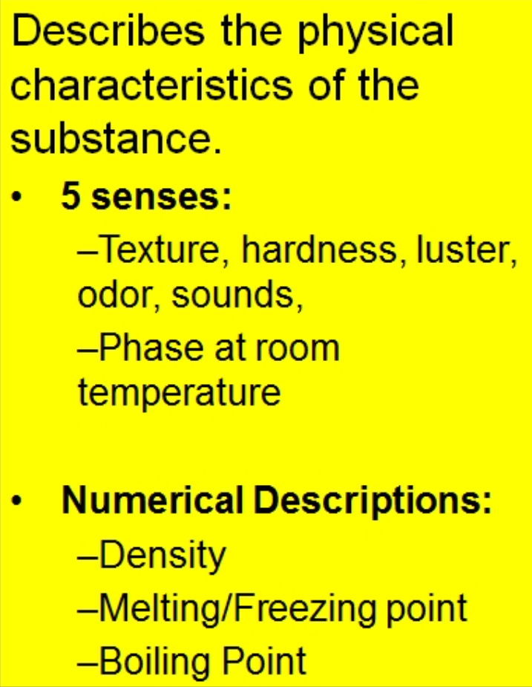
Physical Property-

Slide 22
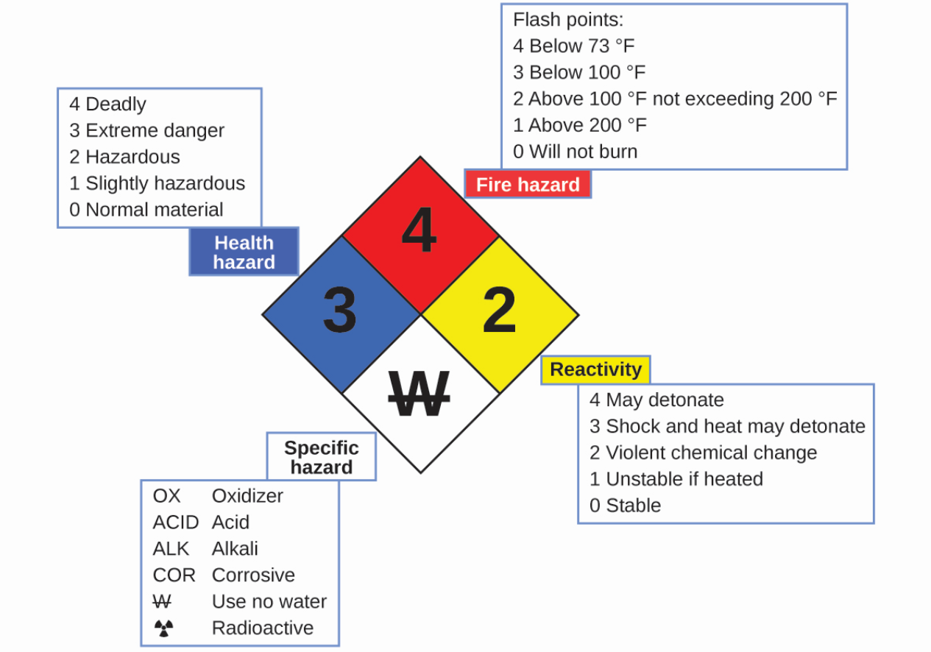
THE HAZARD DIAMOND

Slide 24
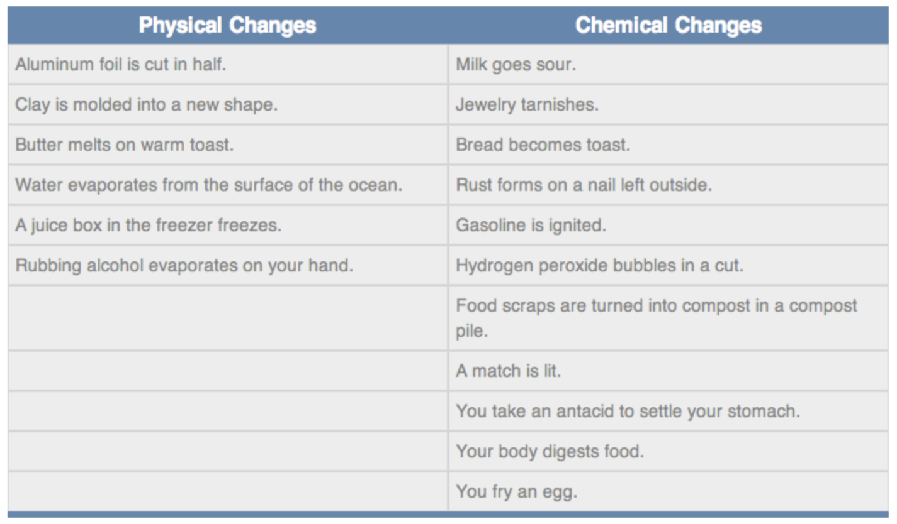

Slide 25
Properties of matter fall into one of two categories. If the property depends on the amount of matter present, it is an extensive property. The mass and volume of a substance are examples of extensive properties; for instance, a gallon of milk has a larger mass and volume than a cup of milk. The value of an extensive property is directly proportional to the amount of matter in question.
If the property of a sample of matter does not depend on the amount of matter present, it is an intensive property.

Slide 27
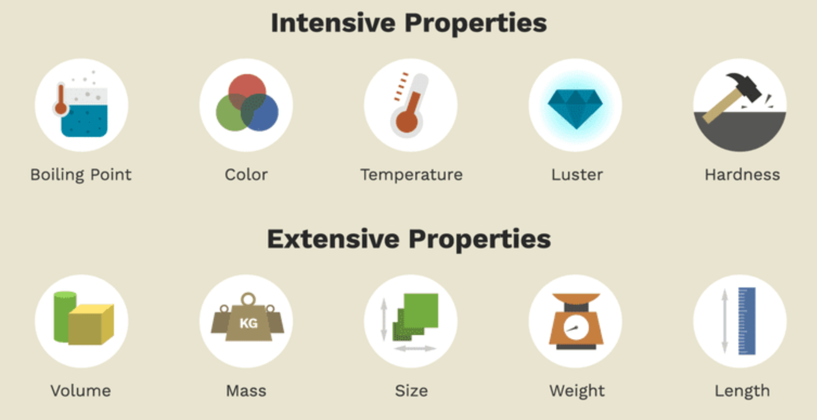

Slide 28
1.3 Vocabulary
chemical change
change producing a different kind of matter from the original kind of matter
chemical property
behavior that is related to the change of one kind of matter into another kind of matter
extensive property
property of a substance that depends on the amount of the substance
intensive property
property of a substance that is independent of the amount of the substance
physical change
change in the state or properties of matter that does not involve a change in its
chemical composition
physical property
characteristic of matter that is not associated with any change in its chemical composition

