Slide 1
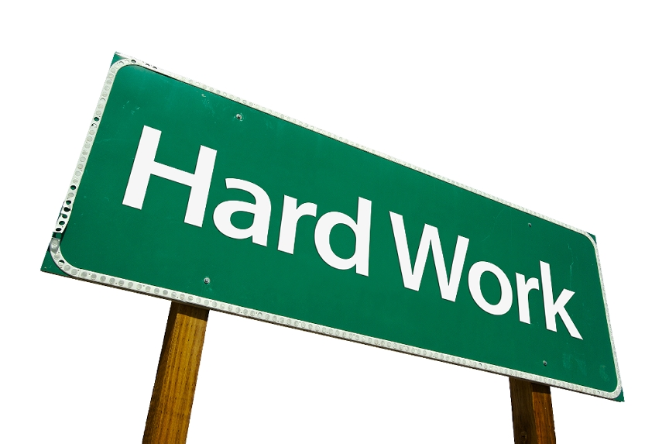
Today I will do what others won’t, so that tomorrow I can do what others can’t.
-Jerry Rice

Slide 2
ACT Science Intro

Slide 3
ACT Science
7 Passages
5-7 Questions Each
40 Questions
35 Minutes
Designed so that time will be an issue!

Slide 4
Three Types of Passages
*Charts and Graphs (15q’s in 3 passages)
DATA REPRESENTATION (embedded in all)
Experiments (18 q’s in 3 passages)
RESEARCH SUMMARIES ask about
Appropriateness of experimental design
Impact of modifications in design
Underlying scientific concepts
Relationship between data and concepts
Meaning of results and implications for future research
Conflicting Scientists (7 q’s in 1 passage)
You NEVER have to choose which is correct!

Slide 5
Science Section Vocab
You don’t have to memorize vocab for the ACT
Knowledge of “science words” will help!

Slide 6
Absorption-process by which products of digestion move from small intestine to blood | Acid- a compound that dissociates in water to form hydrogen ions
Atom- has a nucleus that contains neutrons and protons (+ charge); electrons (- charge) | Base- a compound that forms a salt and water following reaction with an acid
Calorie- the amount of heat needed to raise the temperature of one gram of water 1 degree C | Catalyst- a substance that changes (usually speeds up) the rate of a chemical reaction without itself being permanently changed
Chemical reaction- any process that results in the production of different substances with new properties | Chlorophyll- a complex green pigment that captures light energy, for use in photosynthesis
Chromosome- a structure, composed primarily of DNA, that contains the genes | Compound- two or more elements combined chemically in definite proportions by weight
Control- Treatment group used for comparison | Constant- Variable that stays the same
Density- mass per unit of volume | Diffusion- the movement of molecules from a region of greater concentration to a region of lesser concentration
DNA-(deoxyribonucleic acid) the hereditary material in cells | Element- a substance that cannot be chemically changed into a simpler substance; all atoms of an element have the same number of protons
Evolution- change over time | Gas- a substance that takes the shape and fills the volume of its container
Kinetic- energy the energy of motion | Liquid- a substance that takes the shape of the vessel that contains it, but does not necessarily fill its container

Slide 7
Malleable- the ability of a metal to have its shape permanently changed by applying a force, e.g., hammering | Mass- the measure of the amount of matter in an object; the mass of an object remains the same regardless of the force of gravity
Molecule- the smallest unit of an element or a compound, 2+ atoms covalently bonded | Nucleus- the cell organelle that controls the cell’s activities and contains DNA
Organic- relating to compounds that contain carbon and hydrogen | Permeability- the extent to which a membrane allows different molecules to pass through it
pH- a measure of the acidity of a solution; a pH of 7 is neutral, less than 7 is acidic, and greater than 7 is basic | Photosynthesis- the process in which energy is used to form carbohydrate and oxygen from carbon dioxide and water
Protein- complex organic molecule composed of a chain of amino acids | Radioactive- elements that emit particles and radiation during the spontaneous disintegration of their nuclei
Reflection- occurs when light bounces off a surface | Solid- matter that has a definite shape and volume
Solution- a homogeneous mixture formed when one substance dissolves in another | Solvent- a substance in which a solute dissolves to form a solution
Viscous- describes a material that flows slowly | Weight- the measure of the gravitational force that attracts an object; the weight of an object changes as the force of gravity changes

Slide 8
ACT Science Questions
Fetch the answer
(easy questions)
Analyze based on the given info
(medium questions)
Generalize and make the appropriate conclusions
(hard questions)

Slide 9
Ordering the Questions to Maximize Time
Questions are NOT in “easy to hard” order
All questions are worth the SAME amount!
Up to you to order the questions to maximize your chance of success!

Slide 10
Ordering Science Questions
Question Type
Question Type
Easy, Most Specific
Hard, most general
Easy/fast/short
Medium
Medium
Hard/long/slow
Fetch Questions
Ask you to simply find information from the chart/graph/experiment
Analyze Questions
Ask you for “1-step” analysis based on information stated
General Questions
Ask you to draw general conclusions and draw comparisons between charts/scientists/experiments
Notes:
After going over how to order these questions, have students take the practice passage and simply order the questions (not do them) from easiest to hardest

Slide 11
Easy Questions
Ask you to simply look at the chart/graph/experiment
Approx 10-15 of the 40 questions
Can be answered quickly…do them first!
Will NOT try to trick you

Slide 12
Medium Questions
1-Step Analysis of information given
15-20 of the 40 questions
Answers must have direct support from the passage

Slide 13
Infer/Suggest/Imply
If an ACT science passage provided the following statement…
Ms. Nelson came to class this morning with wet hair.
What can be inferred from the preceding statement?
(A) She ran through the sprinklers
(B) She was sweating from the gym
(C) She showered before class
(D) Her hair is not dry

Slide 14
Interpolate Questions These questions will ask you to estimate a value WITHIN the graph
?

Slide 15
Interpolate example
What is the distance traveled at t= 8.5 seconds?

Slide 16
Extrapolate Questions
These questions will ask you to use the known data to expand to an area not yet known…
?

Slide 17
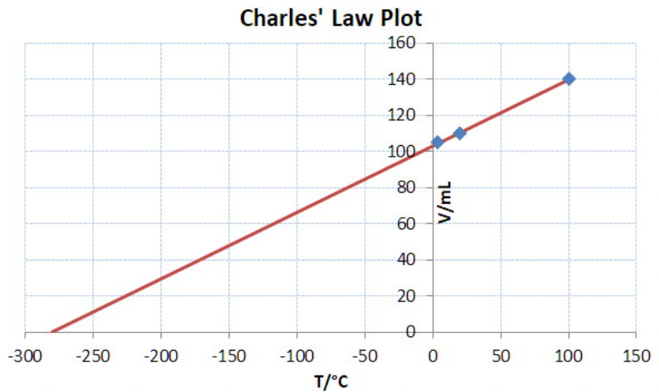
Extrapolate Example
What should the label be for each of these graphs?
What are the constraints on the data collected for each?

Slide 18
Difficult Questions
Will ask you to make general conclusions based on the given info
Mostly appear on “fighting scientists” and experiments passages
Include questions such as
“What if…”
Compare/contrast

Slide 19
Correct Answer Puzzle-Fit
The ACT uses Science passages to test your ability to identify and comprehend a FEW key sentences in the passage.
Then, all of the questions surround these few ideas.

Slide 20
So What?
The answer choices that you‘ve circled should fit together in that they all agree with one another. These correct answers should seem repetitive and fit within the main idea of the graph, hypothesis, or experiment..
If they don‘t, go back and see which ones stand out as not fitting in your puzzle.
If you can‘t see a pattern, you‘ve probably misunderstood or failed to identify the key points of the author‘s argument

Slide 21
Ordering the Questions Drill
___ The results of experiments 1 and 2 indicate that…
___ Which of the following items serves as the control in the experiment
___ Based on the above experiments, which of the following is the most likely conclusion…
___ Suppose the plant described in experiments 1-5 is cut off while in the light, and a new plant doesn’t grow. What will happen to the plant?

Slide 22
Steps to Solving Science Passages
Step 1. Skim the passage to understand the main points/goals/relationship between variables
Step 2. Identify each Question Type
Step 3. Make Educated Guesses
Step 4. Use POE

Slide 23
Charts and Graphs Passages

Slide 24
Four Types of Charts/Graphs on the ACT
Linear Graphs
Graphs with Curves
Scatter Plots
Flat Lines

Slide 25
What to do when you see a Graph/Chart
1. What are the variables? (temperature, number of plants, records sold, hp, mph)
2. How are they measured? (grams? Quarts? Percentages?)
3. How are they related/changing? (+, -, NR)

Slide 26
Line Graphs
Positive Relationship = direct Relationship = ALWAYS PUT A (+)
Negative Relationship = inverse /indirect Relationship = ALWAYS PUT A (-)

Slide 27
Line Graphs Drill
In each of the following graphs, identify the
Variables
How they are measured
How they are related/changing

Slide 28
Graphs with Curves
Still decorate with a + or a - Might need several +’s or –’s, or an OVERALL + & –.
Curve Graphs Drill
In each of the graphs, identify the
Variables
How they are measured
How they are related/changing

Slide 29
Scatter Graphs
Still decorate with a +/-/NR .
Draw in the LINE OF BEST FIT
Line of Best fit- straight line that best represents the data on a scatter plot
Drill
Draw a Line of Best Fit for the three graphs below…

Slide 30
Flat Graphs
These graphs will not have a +/- relationship, but that does NOT mean that these variables are not related.
Drill
In the flat graph above, identify the
Variables
How they are measured
How they are related/changing

Slide 31
Tables
Treat tables the same way that you treat graphs!
When you see a table, make sure to identify the…
Variables
Units of measurement
Relationship between variables

Slide 32
Experiments

Slide 33
Steps to Solving Experiments Passages
Step 1. Scan the passage
Step 2. Identify the objective of the experiment(s)
Step 3. Identify how the research is being done
Step 4.Identify the results of each experiment
Step 5. Answer the questions in “easy to hard” order
Step 6. Use POE

Slide 34
Independent vs. Dependent Variables
Every experiment has two variables – or things that will change.
Independent Variable: The variable that you are investigating. The thing that causes the DV to have different measurements.
Dependent Variable: The variable you are going to measure in your experiment

Slide 35
Experiment example graph

Slide 36
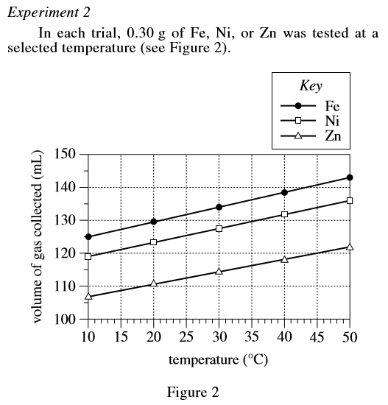

Slide 37
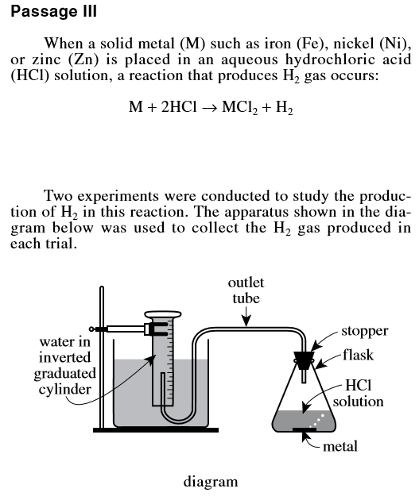
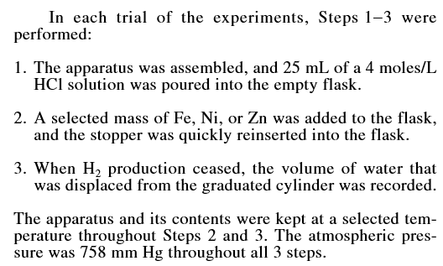

Slide 38
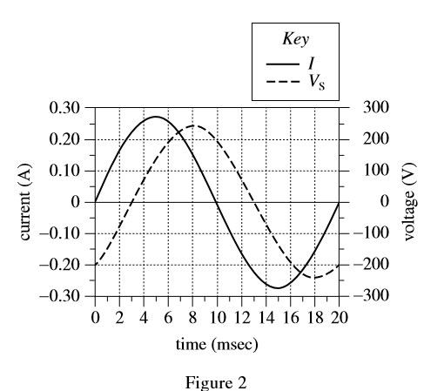

Slide 40
Conflicting Scientists

Slide 41
Conflicting Scientists
Step 1. Read hypothesis 1-determine argument.
Step 2. Answer all questions that ask about hypothesis 1 only
Step 3. Read hypothesis 2-determine argument.
Step 4. Answer all questions that ask about hypothesis 2 only
Step 5. Answer questions that ask about the “puzzle fit” of the two hypotheses

